Slide 1
Arrays
Creative Commons Attribution-NonCommercial-ShareAlike 3.0 Unported License. http://creativecommons.org/licenses/by-nc-sa/3.0/
Written by Rachel J. Morris, last updated 2015-01-14

Slide 2

What are arrays?
In C++, arrays are the simplest data-type for storing a series (list, array) of values.
Some characteristics of simple arrays:
All elements stored in the list must be of the same data-type
There are no functions for our arrays – for example, we must keep track of the array's size manually
An array cannot be resized; you set a specific size during its declaration and it cannot change.
“while not done”

Slide 3
What are arrays?
Arrays can store any data-type that you could use for a variable:
int
string
float
bool
“while not done”
Even user-made objects

Slide 4

What are arrays?
Each element in an array has its own index, which is its position in the array.
The first index is 0
In an array of size 4, the first element is at index 0 and the last one is at index 3.
“cheese”
“tomato”
“bacon”
“lettuce”
“while not done”
Index:
0
1
2
3

Slide 5
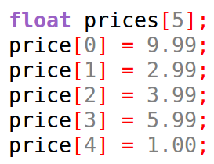
Array declaration
Like a normal non-array variable, an array declaration requires the data-type and the name of the variable, but we must also specify the array's size when creating it.
Size of the array
Declaration
Assigning values to each element
Index

Slide 6
Array declaration
We can declare an array without the size specified only if we are initializing the array with a list of data.
0 1 2 3 4
We still need the square brackets [] to specify that this is an array.

Slide 7
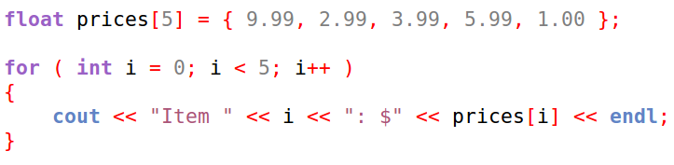
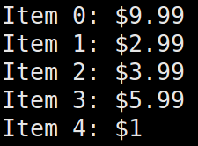

For Loops and Arrays
For loops are really handy once we're using arrays.
We can use a for loop to iterate through all the elements of an array

Slide 8
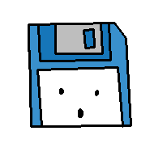
Why no resizing?
When we get into memory management, we will learn how to make dynamic arrays – arrays that can be assigned a size at run-time, instead of hard-coded into the program code.
The reason the C++ array does not have the ability to resize deals with memory allocation.

Slide 9
Why no resizing?
When an array is declared, as with any variable, memory is set aside for this item.
The amount of memory taken up is dependent on the data-type.
int and float = 4 bytes, bool = 1 byte.

Slide 10
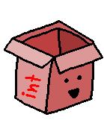


Why no resizing?
An array allocates enough memory for n amount of that data-type, where n is the size of the array.
= 4 bytes
5 elements, 4 bytes each
= 20 bytes

Slide 11
Y U NO RESIZE?
Additionally, the elements in the array are stored sequentially in memory – one after another.
Let's say we create an array of size 5, and it takes up 5 memory “blocks”.
But then we create another variable, which takes up the memory “block” after our array.
Elements in an array must be sequential, but we cannot add to the array because that memory is taken up by something else.
0
1
2
3
4
0
1
2
3
4
0
1
2
3
4
5
6
NOPE

Slide 12
Y U NO RESIZE?
Well, why can't we store different elements in an array at different places in memory?
0
1
2
3
4
5
6
7
Arrays in C++ aren't “smart” enough to handle keeping track of its elements like this.
It knows enough to “walk” through its elements, and how big each element is (because they're all the same data-type!)

Slide 13

Y U NO RESIZE?
Why can't C++ do it? I can do that!
0
1
2
3
4
5
6
7
We can do that – we can write a class (object) that intelligently handles elements in an array, so we can resize the array whenever we want!
We will do this later on, after we've covered pointers and classes.

Slide 14
Arrays as Arguments
So, arrays can potentially take up a lot of memory.
So, arrays can potentially take up a lot of memory.
Because of this, when arrays are passed into a function call as an argument, they are automatically
passed by reference,
not passed by value.
If they were passed by value by default, like non-array variables, your program would be really inefficient, and could potentially slow down. A lot.

Slide 15
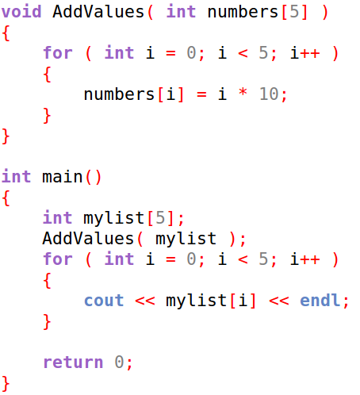
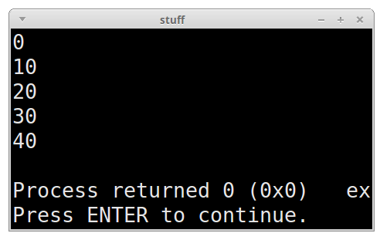
Arrays as Arguments

Slide 16
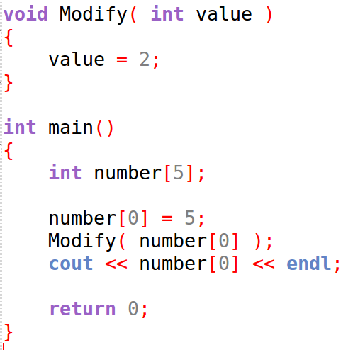

Arrays as Arguments
However, if we just pass one element of an array to a function, it is copied over,
like any other non-array variable.

Slide 17
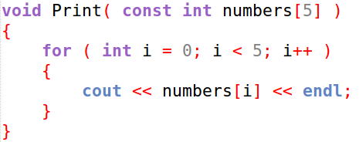
Arrays as Arguments
But what if we want to pass an array to a function,
But we want to make sure the data in the array doesn't change?
Time for const!
Like with other pass by reference parameters, you can use const so that you can get the benefit of the speed of
passing by reference, with the benefit of not being able to change a value, like with pass by value.

Slide 18


Multidimensional Arrays
Our arrays don't need to be one dimensional. We can have arrays that are 2D, 3D, and more!
Though if you find that your arrays are getting really complex, you might want to create a class or struct instead...
(More on that in another lecture)

Slide 19
Problems with Arrays
Arrays are pretty basic, so there are some problems you will need to look out for when writing programs.

Slide 20

Problems with Arrays
Arrays are pretty basic, so there are some problems you will need to look out for when writing programs.
For one, arrays don't keep track of what their size is.
You have to manually keep track of this.
Keep in mind the size!
Because of that, you will need to be careful to make sure the program does not try to access an index outside of the array – causing an index out of range error.

Slide 21
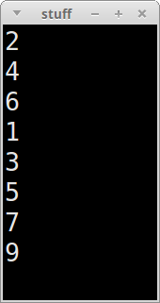
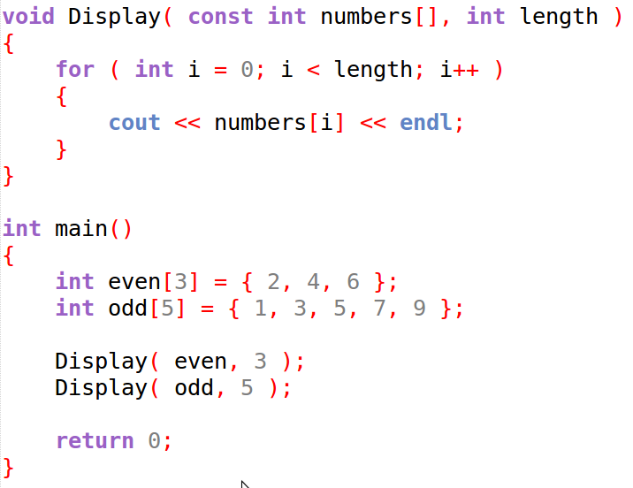
Problems with Arrays
When passing an array, the size isn't required to be specified.

Slide 22
Problems with Arrays
Arrays are pretty basic, so there are some problems you will need to look out for when writing programs.
For one, arrays don't keep track of what their size is.
You have to manually keep track of this.
Keep in mind the size!
Because of that, you will need to be careful to make sure the program does not try to access an index outside of the array – causing an index out of range error.

Slide 23
Problems with Arrays
Another problem is that, even if you created an array of some size, that doesn't mean all the elements have been filled.
Beyond the maximum array size, you might also need to store how many elements are currently in the array.
If you access an element that has not been initialized, you will get garbage, just like if you declare a non-array variable without initializing it.

Slide 24
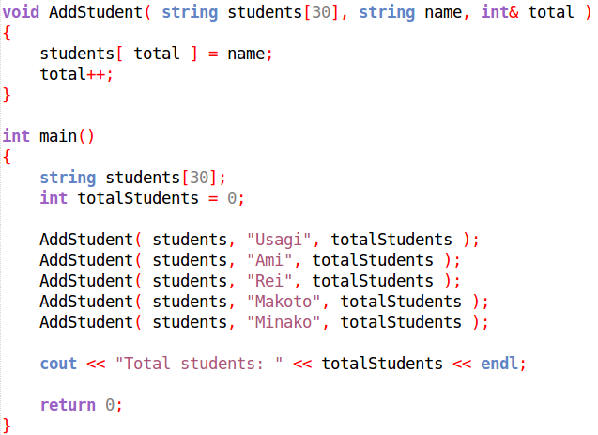

Problems with Arrays
When working with arrays and adding elements in the program, make sure to keep track of what the size of the array is (or, the last index used).

Slide 25
Being able to store a list of like-data is super useful, but it can also be tricky.
Let's work on some programs that will illustrate how we can use arrays

